Slide 1
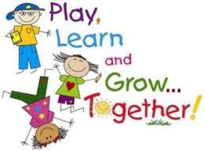
2022-2023 Fall Clusters

Slide 2
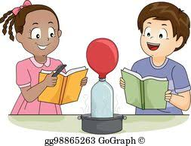
Science in Action K-2
Participate in exciting lab experiments in this cluster! You will have the opportunity to do hands on activities while deepening your understanding of science.

Slide 3
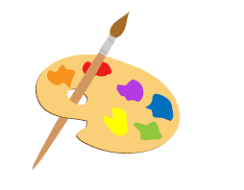
Art K-2
Create different seasonal artwork to display around the school lobby or media center.

Slide 4
K-2 Bully Busters
Learn how to stop bullying and how to spread awareness against bullying

Slide 5
Phonics Fun K-2
Practice mastering your phonics skills in a fun way! You will participate in various hands-on phonics activities that will help you become the reader you strive to be!

Slide 6
Math Facts K-2
Practice mastering your addition and subtraction math facts in an engaging way! You will use hands-on activities, fun games, and much more!

Slide 7
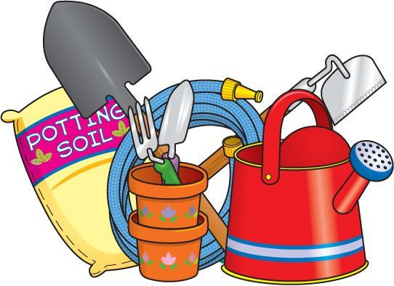
“Garden in” K-2
Plant and beautify the school, while also learning about plants.

Slide 8
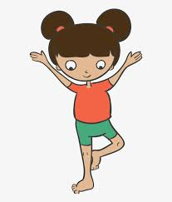
K-2 Yoga
In this cluster you will practice various yoga moves. Students will create a yoga video that they can share on the Luella news for Health M. Powers.

Slide 9
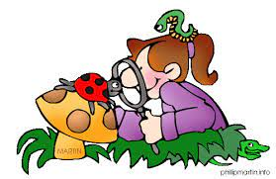
K-2 Animal Science
Students would learn about different animals and how to care for them.

Slide 10
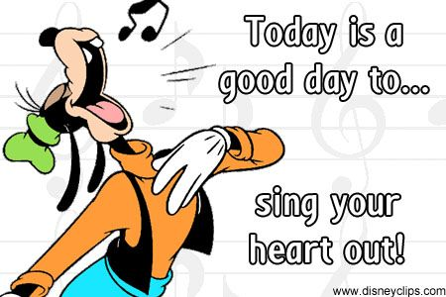
K-2 Sing Your Heart Out
In this cluster you will practice singing songs for school performances.

Slide 11
K-2 American Sign Language
In this cluster you will learn how to sign in American Sign Language. You will even be able to perform a song using American Sign Language.

Slide 12
K-2 Health/ Wellness
You can work on various forms of physical fitness, and can learn about how to make healthier habits.

Slide 13
K-2 Spanish
Learn Spanish to be able to communicate with others. You will even be able to perform songs for the school.

Slide 14
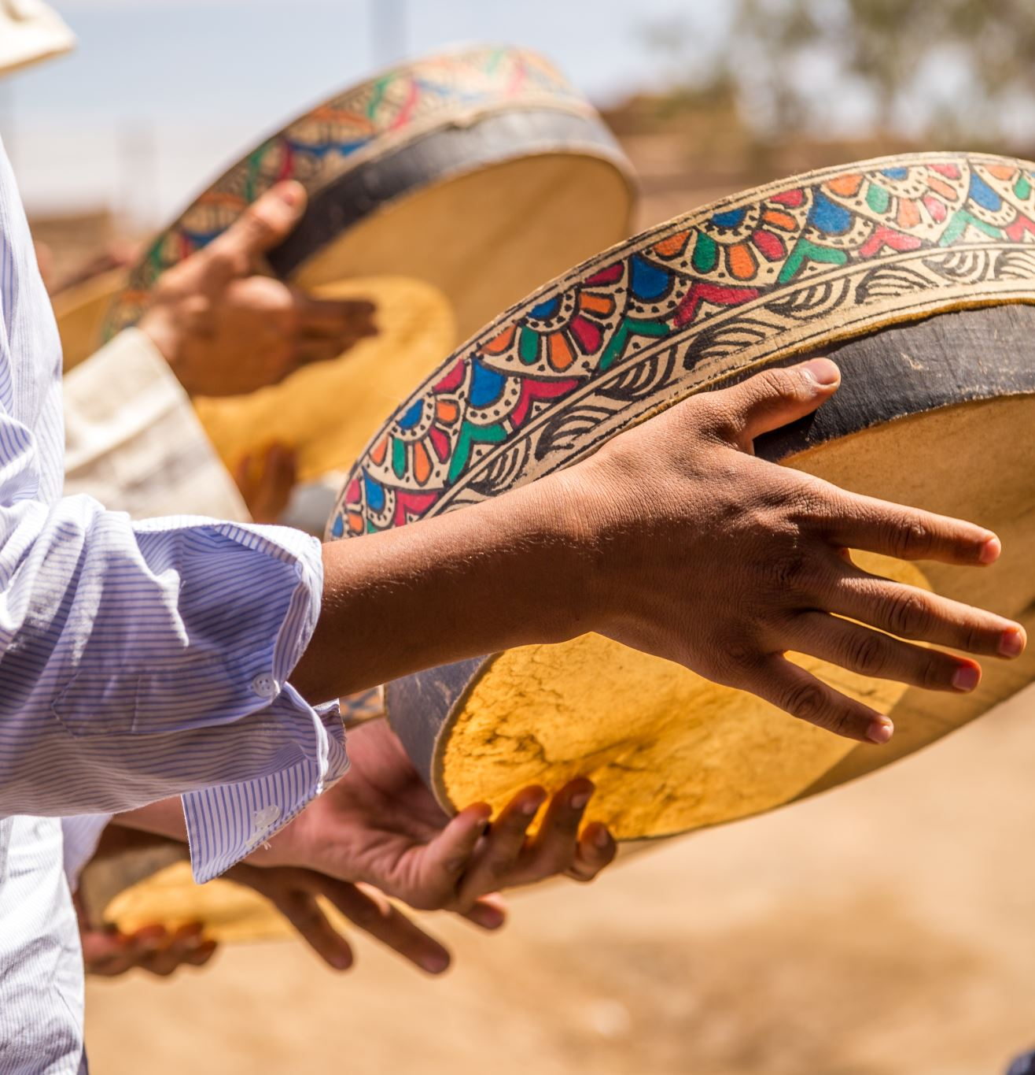
K-2 Culture Company
Learn about different cultures (what they eat, games they play, music, celebrations, ect). Help to bring awareness to different cultures.

Slide 15
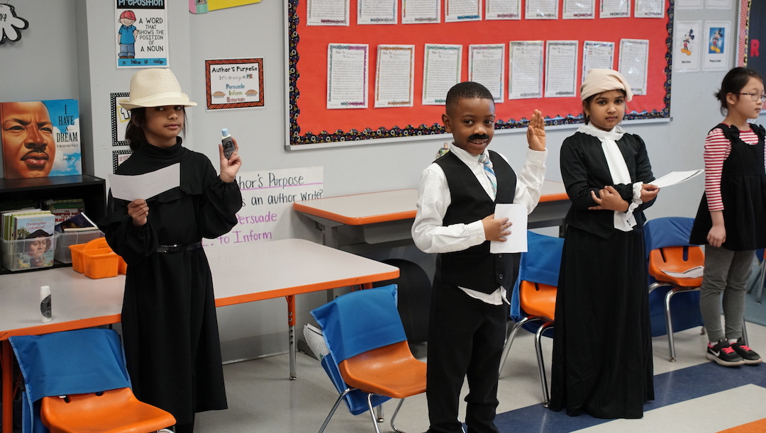
2-3 Wax Museum
Work on learning about different historical figures. You will be able to perform for others by dressing up, memorizing facts about different historical figures.

Slide 16
2-3 Reading Bowl
Picture Book Bowl-Students read 20 picture books and compete against other schools to see who can answer the most questions about the books.

Slide 17
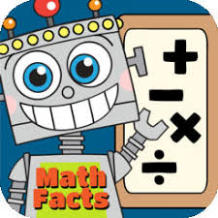
Math Facts 3-5
Practice mastering your addition, subtraction, multiplication, and division math facts in an engaging way! You will use hands-on activities, fun games, and much more!

Slide 18
“Garden in” 3-5
Plant and beautify the school, while also learning about plants.

Slide 19
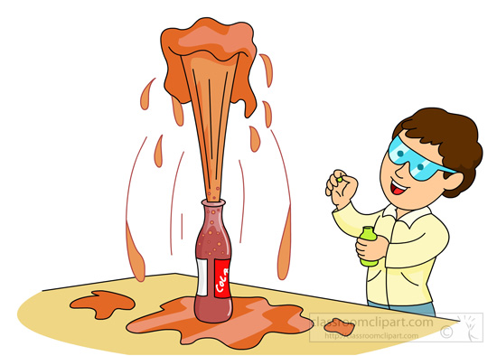
Science in Action 3-5
Participate in exciting lab experiments in this cluster! You will have the opportunity to do hands on activities while deepening your understanding of science.

Slide 20
Props for Aladdin 3-5
In this cluster you will be making backdrops/ props for the Aladdin play.

Slide 21
3-5 Bully Busters
Learn how to stop bullying and how to spread awareness against bullying

Slide 22
3-5 Step/Dance
Work on some dance moves and be ready to perform for your school!

Slide 23
3-5 Sing Your Heart Out In this cluster you will practice singing songs for school performances.

Slide 24
3-5 Health and Wellness
In this cluster you will learn how to create healthy habits, and how to incorporate physical fitness into daily life.

Slide 25
3-5 Wax Museum
Work on learning about different historical figures. You will be able to perform for others by dressing up, memorizing facts about different historical figures.

Slide 26
3-5 Mind Puzzles
In this cluster you will work on solving different puzzles by thinking outside the box.

Slide 27
Robotics 4-5
If you love engineering and robotics, then this is the cluster for you. Learn to build your own robots and use other robotics!

Slide 28
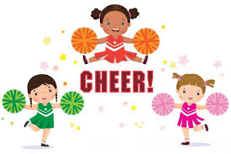
Cheer 4-5
Learn cheers to support our LES Lion Cubs! Cheerleaders may be performing at special school functions!

Slide 29
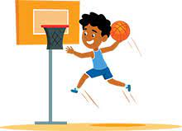
Basketball 4-5
In this cluster you will learn the fundamentals of basketball and get to participate in playing basketball.

Slide 30
4-5 Aladdin Play
In this cluster you will learn the songs and choreography to the Aladdin play in spring.

Slide 31
4th-5th Reading Bowl
Grade students: Reading Bowl- Students read 10 chapter books and compete against other schools to see who can answer the most questions about the books.

Slide 32
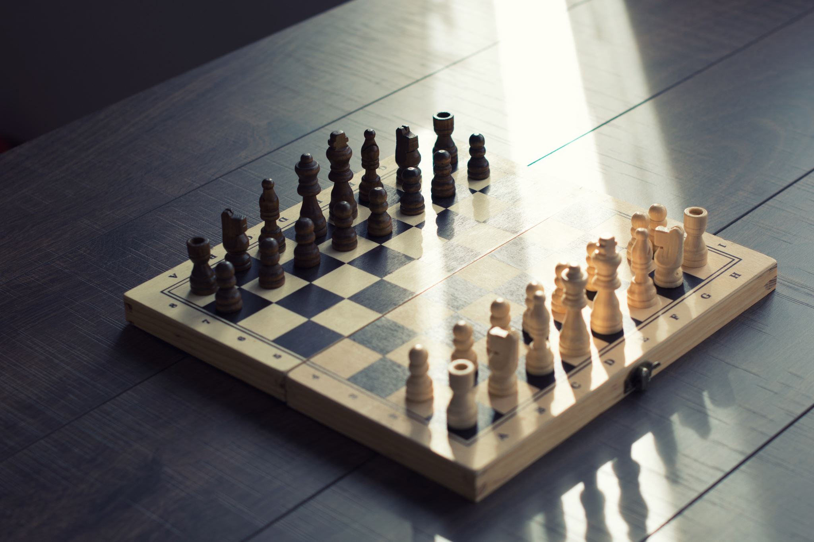
4-5 Chess Club
In this cluster learn the fundamentals of chess. You will also have an opportunity to compete in a chess match.

